Slide 1
Food and Beverage Management
Chapter 9 - Production

Slide 2
Production Planning
1st step to meeting guest expectations
Should be tailored to the needs of the operation
Stakeholder involvement
Primary purpose is to determine the quantity of menu items to prepare
Use historical records to generate

Slide 3
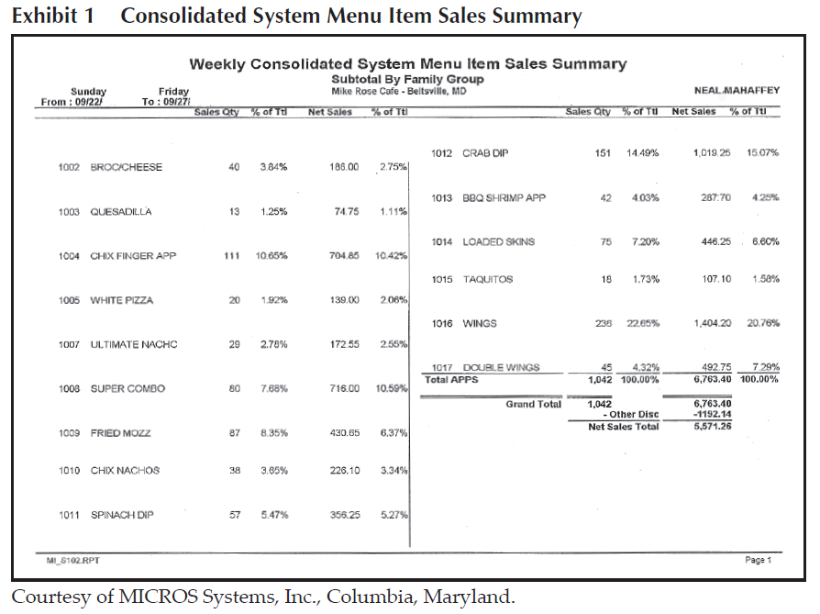
Estimating Production

Slide 4
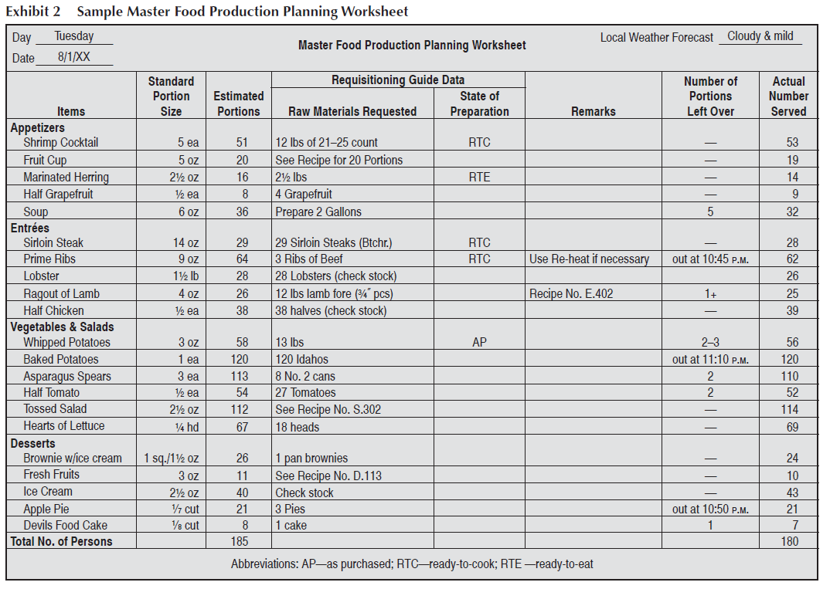
Estimating Production

Slide 5
Food Production
Steps –
Planning
Preparing
Cooking
Service/Holding

Slide 6
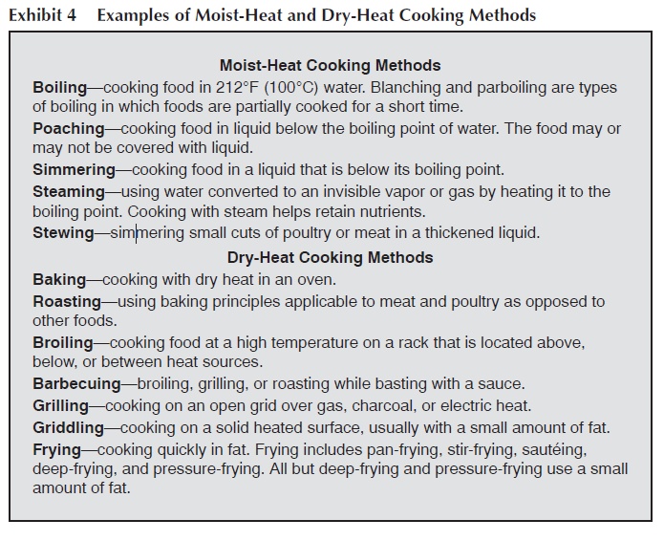
Basic Cooking Methods

Slide 7
Food Production Principles
Begin with Quality Foods
Clean Properly
Properly Handled
Use Proper seasoning
Use the right techniques
Follow standard recipes
Cook the right amount
Serve as soon as possible
Hot food hot – cold food cold
Make it special
Never be satisfied with less than excelllent

Slide 8
Fresh Fruits
Fruit refers to the matured ovary of a plant, including seeds.
Fruits are high in carbohydrates, water vitamins and minerals
Handle as little as possible
Fruit costs are affected by:
Perishability
Pesticides
Weather
Consumer preferences
Packaging
Processing

Slide 9
Fresh Vegetables
Refers to any plant grown for food for an edible part other than the ovary
Generally have less sugar and more starch than fruits
Rich in vitamins and minerals
Careful washing is important
Pare thinly to retain essential vitamins and minerals
Purchase for immediate consumption

Slide 10
Vegetables
Roots – Sweet potatoes, beets, carrots
Tubers - potatoes
Bulbs – onions, garlic, leeks
Stems –celery, rhubarb, asparagus
Leaves – lettuce, spinach, cabbage
Flowers – cauliflower, broccoli, artichokes
Pods and seeds – green beans, peas, lima beans
Sprouts – soybean, sunflower
Vegetable Fruits – tomatoes, eggplants, squash, pumpkin, okra, cucumbers

Slide 11
Fruit and Vegetable Salads
Use fresh ripe products
Variety of colors
Use varied textures
Use the right tools
Freshen washed vegetables in cold water
Chop into uniform sizes, avoid crushing
Handle gently
Add dressing just prior to service
Keep refrigerated until just prior to service

Slide 12
Types of Salads
Hot salads
Cold salads
Fruit salads
Pasta salads
Tossed salads
Molded salads – gelatin base

Slide 13
Dressing and Marinades
Dressings are stable or unstable emulsions
Emulsion is the mixture of two or more liquids than are ordinarily unmixable
Marinades are seasoned liquids that are usually made with vegetable or olive oil, and an acid wine, vinegar, fruit juice
Herbs, spices and vegetables are added for flavoring
Can be used to tenderize or be used as a cooking medium or sauce

Slide 14
Garnishes
Fruits and vegetables typically used
Use the characteristics of each to offer a variety of form, color and textures
Use your imagination
Must be edible!

Slide 15
Cooking Fruits and Vegetables
Steaming
Baking
Frying (stir fry, deep fry)
Microwaving
Boiling (blanching)
Vacuum processing (sous vide)

Slide 16
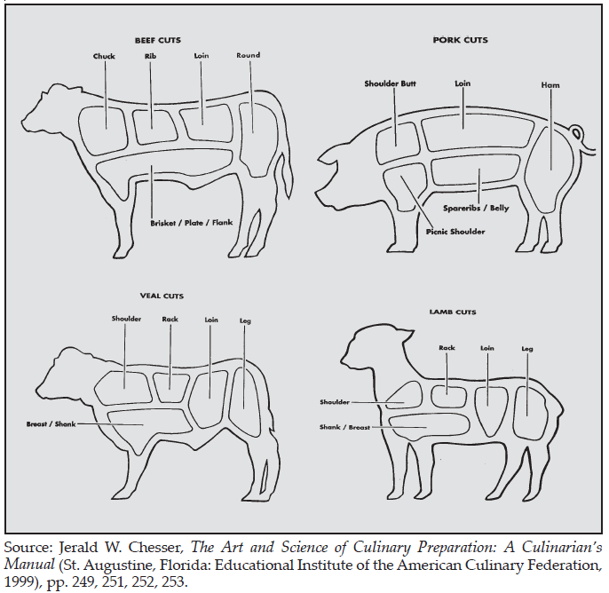
Meat Cuts

Slide 17
Meat
Components
Muscle fiber
Connective Tissue
Fat
Bone
Tenderness
Fat
Cut
Age
Temperature

Slide 18
Cooking Meat
Goals include improving flavor, changing color, tenderizing, and destroying pathogens
Methods
Roasting
Broiling
Pan Broiling
Frying
Braising
Simmering
Pressure Cooking
Other – Stocks – brown and white, bouillon

Slide 19
Fish
Types –
Fin Fish
Shell Fish
Cooking Methods
Frying
Broiling
Baking
Acid

Slide 20
Eggs
Cooking Considerations
Use as soon as possible after purchase
Boiling can cause them to become rubbery
Hard cooked eggs – no longer than 15 minutes
Soft boiled eggs 1 to 3 minutes
Immerse in cold water to stop cooking process
Poaching
Cook at lowest possible temperature

Slide 21
Uses
Binding and coating
Leavening Agent
Emulsifying agent
Interfering Substance (sherbets, etc)
Clarifying agent

Slide 22
Dairy Products
Pasteurization – process that controls heat to destroy bacteria
Homogenization – breaks up fat particles so they remain suspended in the milk
Milk is delicate – can scorch, curdle and is highly perishable

Slide 23
Cooking with Milk & Cheese
Milk
Heat should be kept as low as possible
Preferably in a double boiler
Stir frequently
Cheese
Proteins coagulate with heat – can get tough and rubbery

Slide 24
Baking
Flour
Leavening agents
Eggs
Yeasts
Baking soda
Baking Powder
Fat –
Fats that are plastic cab hold shape in a batter or dough
Liquids
Eggs
Sugar

Slide 25
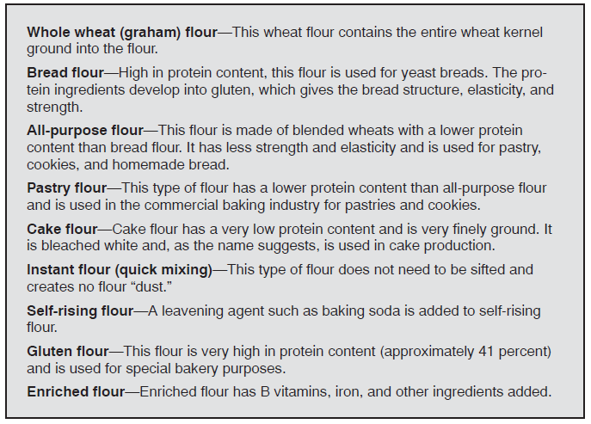
Common Baking Ingredients

Slide 26
Coffees & Teas
Coffee
Should be held at 185 F – never allow to boil
Make Ice coffee 2X stronger to compensate for ice
Tea
Steep in cup no longer than 5 minutes
2 oz tea to 1 gallon of water
Make ice tea stronger to compensation for ice

Slide 27
Green Restaurants
Recycle
Use recycled products
Choose sustainable menu items
Buy locally
Clean & Maintain equipment
Install energy efficient equipment & lighting
Reduce and reuse

